Slide 1

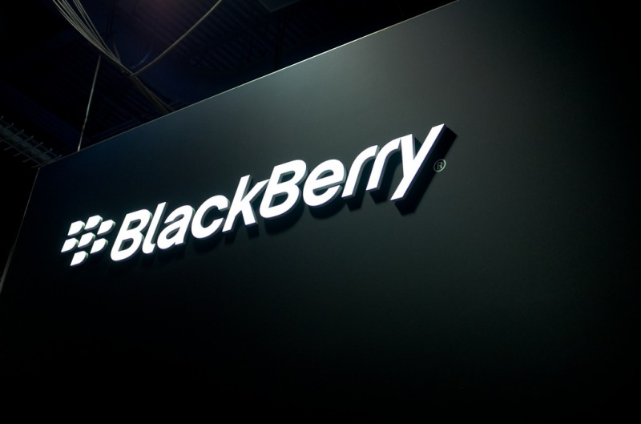
Saurabh Ghumnar
BADM 543: Technology Strategy
Notes:
Best Team

Slide 2







Porters Five Forces Industry Analysis
Threat of Entry: MODERATE
Buyer Power: HIGH
Industry Rivalry: VERY HIGH
Supplier Power: MODERATE
Threat of Substitutes: HIGH
High capital requirements
Brand loyalty of incumbents
Emergence of cost-effective players
Dependence on key component suppliers
Commoditization of parts
Multiple supplier options
Emergence of tablets, wearables
Cloud-based solutions reducing hardware dependence
Numerous alternatives
Demand for innovation
Competitive pricing
Dominance of major brands
Rapid innovation cycles
Aggressive marketing and pricing strategies
Notes:
Threat of New Entrants – Moderate: Entering the smartphone industry requires substantial capital investment in R&D, manufacturing, and marketing. Established brands like Apple and Samsung have significant economies of scale and brand loyalty, creating high entry barriers. However, the emergence of Chinese manufacturers like Huawei and Xiaomi, which offer competitive products at lower prices, had increased the threat of new entrants in certain market segments.​
Bargaining Power of Suppliers – Moderate: BlackBerry relied on a limited number of suppliers for key components, such as processors and screens. This dependence gave suppliers moderate bargaining power, especially when demand for components was high. However, the commoditization of many smartphone components and the presence of multiple suppliers mitigated this power to some extent.
Bargaining Power of Buyers – High: Consumers had a wide array of smartphone options with similar features and pricing. The ease of switching between brands, coupled with the availability of various operating systems and app ecosystems, gave buyers significant power. This forced manufacturers, including BlackBerry, to continuously innovate and offer competitive pricing.
Threat of Substitutes – High: The rapid advancement of technology introduced various substitutes for traditional smartphones. Tablets, phablets, and wearable devices began to offer similar functionalities. Additionally, the rise of cloud computing and web-based applications reduced the dependence on specific hardware, increasing the threat of substitutes
Industry Rivalry – Very High: The smartphone industry was characterized by intense competition among major players like Apple, Samsung, and emerging Chinese brands. Frequent product launches, aggressive marketing strategies, and rapid technological advancements intensified the rivalry. BlackBerry's decline in market share and inability to keep pace with competitors' innovations exemplify this fierce competition.
References:
Canvas Business Model. (n.d.). Blackberry - Porter's Five Forces. Retrieved April 29, 2025, from https://canvasbusinessmodel.com/products/blackberry-porters-five-forces
Cornell Blogs. (2016, October 16). Blackberry and Porter’s Five Forces Analysis. Retrieved April 29, 2025, from https://blogs.cornell.edu/info2040/2016/10/16/blackberry-and-porters-five-forces-analysis/
Scribd. (n.d.). BlackBerry Porter’s Five Forces. Retrieved April 29, 2025, from https://www.scribd.com/document/445737476/1
Harvard Business Review. (2013). Why BlackBerry Failed. Retrieved from https://hbr.org/2013/09/why-blackberry-failed
Statista. (2024). Smartphone Market Share Worldwide. Retrieved from https://www.statista.com

Slide 3
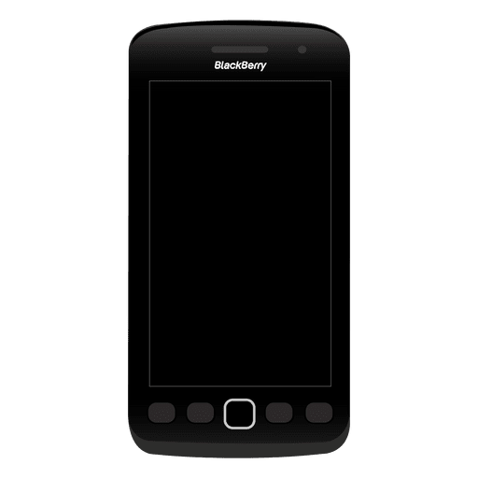




VRIN Analysis: BlackBerry’s Key Resources & Capabilities
Resources | V | R | I | N | S/W (Strategic Role or Weakness)
Secure Messaging Tech | ✓ | ✓ | ✓ | ✓ | S: Legacy strength that still builds trust in high-security sectors (e.g., gov, finance)
Operating System | ✓ | ✓ | ✓ | ✓ | S: Core to BlackBerry’s presence in auto, medical, and embedded markets
Cybersecurity | ✓ | ✓ | ✓ | ✓ | S: Powers BlackBerry’s new identity in proactive, AI-based threat protection
Brand Reputation | ✓ | X | X | X | W: Recognized brand, but no longer creates differentiation or loyalty in the modern tech space
Capabilities | V | R | I | N | S/W (Strategic Role or Weakness)
Enterprise Client Network | ✓ | ✓ | ✓ | ✓ | S: Long-term B2B relationships are sticky, especially in defense and enterprise sectors
Security-First Product Focus | ✓ | ✓ | ✓ | ✓ | S: Deep specialization enables differentiation from generic competitors in B2B security
Software Transition Execution | ✓ | X | X | X | W: Still catching up to leaders in scale and reach; execution is improving but uneven
Notes:
BlackBerry’s early success was built on secure communication - a valuable and rare capability at the time. But as the mobile industry evolved, the company struggled to maintain an edge. This VRIN analysis helps explain why.
Let’s walk through it:
Secure Messaging & Encryption This was a core strength. It was valuable, rare, hard to copy, and difficult to replace. In fact, it’s one of the few areas where BlackBerry sustained a real competitive advantage - especially in government and enterprise markets.
QNX Operating System This system, now used in cars and embedded devices, meets all VRIN criteria. It’s a strategic asset that helped BlackBerry stay relevant beyond smartphones, particularly in the auto and IoT space.
Cylance AI Cybersecurity Acquired later in BlackBerry’s journey, this is a strong capability. It’s still emerging but offers value and uniqueness, especially as cybersecurity demand grows. This asset supports BlackBerry’s repositioning as an enterprise security firm.
Enterprise Client Network BlackBerry’s long-term relationships with governments and businesses are rare and difficult for rivals to replicate. These relationships remain valuable and have helped the company survive post-smartphones.
However, some resources lost their edge over time:
Brand recognition was once a strength, but it became less rare and easy to imitate. It no longer provided a true competitive advantage once consumer preferences shifted toward design, apps, and ecosystem integration.
In summary, this VRIN analysis shows that while BlackBerry had real advantages, it didn’t scale or evolve them fast enough. Meanwhile, competitors built resources that stayed valuable and relevant - leaving BlackBerry to play catch-up in the software space.
References:
Clazri. (n.d.). BlackBerry strategic plan. Medium. Retrieved April 29, 2025, from https://medium.com/@clazri/blackberry-strategic-plan-88f361296f14
IBS Americas. (n.d.). Competition demystified: BlackBerry case study. Retrieved April 29, 2025, from https://ibs-americas.com/en/research-and-innovation/publications/articles/38/competition-demystified-blackberry-case-study
Harvard Business Review. (2013). Why BlackBerry failed. Retrieved from https://hbr.org/2013/09/why-blackberry-failed

Slide 4
Mobile Operating System Market Share 2000 - 2021
Notes:
This graph tracks global mobile operating system market share from 2009 to 2021.
In 2009, BlackBerry OS held a noticeable share of the market, around 15–20%.
Its market share peaked briefly, then declined steadily over the following years.
By 2016, BlackBerry OS had fallen below 1%, and remained nearly flat through 2021.
In contrast, Android showed a sharp rise beginning around 2010, surpassing all others by 2012 and reaching over 70% share.
iOS remained relatively stable, gradually increasing its share over the period.
Other platforms like Symbian and Samsung OS also declined significantly.
The graph highlights a complete shift in mobile OS leadership over the decade, with Android and iOS emerging as the clear dominant players.
References:
1. StatCounter. (n.d.). Mobile operating system market share worldwide (Jan 2009–Apr 2021). Retrieved April 29, 2025, from https://gs.statcounter.com/os-market-share/mobile/worldwide/#monthly-200901-202104

Slide 5
Blackberry’s revenue from 2004 to 2019 (in million U.S. dollars)
Notes:
BlackBerry’s financial trajectory is a textbook case of rapid growth followed by a dramatic decline due to strategic missteps and market disruption.
In 2004, the company reported revenues of just $595 million. As its devices gained widespread adoption among professionals and government agencies, revenue skyrocketed.
By 2009, revenue had crossed $11 billion, and it further climbed to $14.95 billion in 2010, peaking at $19.91 billion in 2011 - BlackBerry’s most successful year financially.
However, 2011 also marked a turning point. While BlackBerry was still generating massive revenue, competitors like Apple and Samsung were rapidly capturing market share through more user-friendly and innovative devices.
This amounts to a 95% decline in revenue from its 2011 peak to 2019.
The financial freefall was largely due to BlackBerry’s inability to respond to:
The market shift toward touchscreen smartphones.
Consumer demand for app-rich ecosystems.
The expansion of Android and iOS platforms.
The dramatic revenue collapse highlights how even a market leader can rapidly lose relevance and value when it fails to innovate and adjust its strategy in time.
References:
1. IBS Americas. (n.d.). Competition demystified: BlackBerry case study. IBS Americas. Retrieved April 29, 2025: https://ibs-americas.com/en/research-and-innovation/publications/articles/38/competition-demystified-blackberry-case-study

Slide 6
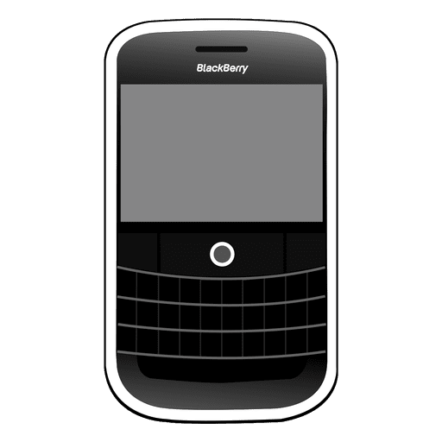
Key Strategic Challenge - What happened?
What Went Wrong
Ignored touchscreen trend - Clung to keyboard devices while
Apple redefined UX Weak app ecosystem - Couldn’t compete with iOS/Android app availability
Enterprise-only mindset - Overlooked rising consumer demand and lifestyle features
Complacency - Believed early success and enterprise loyalty were enough
How could BlackBerry have responded strategically to shifting industry dynamics to sustain its dominance in the smartphone market?
Why This Matters
Market share dropped from 43% (2010) to near-zero within five years
Missed the shift from business tool → lifestyle platform
Rivals (Apple, Samsung, Google) created sticky, ecosystem-based models
Case shows how ignoring customer trends and innovation delays can destroy market leadership
Notes:
BlackBerry’s key strategic challenge - and the focus of this project - is understanding why it lost its dominant position in the smartphone market.
At one point, BlackBerry was a market leader with over 40% share in the U.S. It was widely trusted for secure communication, particularly among business professionals and governments. But the company made a critical mistake: it failed to respond to the changing direction of the mobile industry.
When Apple introduced the iPhone, it completely redefined user expectations. The market shifted toward touchscreen interfaces, rich app ecosystems, and design-focused user experiences. BlackBerry, however, stuck to its physical keyboard design and was slow to build a competitive app platform. It underestimated how quickly consumer demand would evolve - and how much influence consumer trends would start to have on even enterprise purchases.
While Apple and Android created integrated ecosystems, BlackBerry’s approach remained too narrow, focused mostly on business messaging and hardware control. It didn’t pivot fast enough, and as a result, it lost relevance across both consumer and professional markets.
This challenge matters because it’s a classic example of how a lack of innovation and slow response to disruption can erase even the strongest market positions. BlackBerry’s decline shows that holding valuable resources isn’t enough - companies must also adapt those resources to where the market is headed.
References:
Harvard Business Review. (2013). Why BlackBerry failed. https://hbr.org/2013/09/why-blackberry-failed
IBS Americas. (n.d.). Competition demystified: BlackBerry case study. https://ibs-americas.com/en/research-and-innovation/publications/articles/38/competition-demystified-blackberry-case-study
Clazri. (n.d.). BlackBerry strategic plan. Medium. https://medium.com/@clazri/blackberry-strategic-plan-88f361296f14

Slide 7
Strategic Analysis - Option 1
#1: Early Pivot to Touchscreen Smartphones
BlackBerry would rework its hardware design and software UI to prioritize full-touchscreen devices in response to Apple’s iPhone launch.
Pros:
Aligns early with consumer preference shift (post-iPhone)
Maintains relevance in fast-growing smartphone category
Potential to lead a niche in business-grade touchscreen devices
Cons:
Risk of alienating core business users loyal to keyboard
Requires major investment in R&D and OS redesign
Internal resistance to change could slow execution
Notes:
In this option, BlackBerry would have shifted its product strategy to fully embrace touchscreens, aligning with the direction Apple was leading. This would have required rethinking its UI, redesigning hardware, and preparing its OS for a new type of interaction. It was a risky move at the time, especially given the company’s loyal base that loved physical keyboards. However, if executed early, it might have helped BlackBerry stay relevant during a critical industry shift and defend its market share.
References: 1. Harvard Business Review. (2013). Why BlackBerry failed. https://hbr.org/2013/09/why-blackberry-failed
2. IBS Americas. (n.d.). Competition demystified: BlackBerry case study. https://ibs-americas.com/en/research-and-innovation/publications/articles/38/competition-demystified-blackberry-case-study

Slide 8
Strategic Analysis - Option 2
#2: Invest Heavily in App Ecosystem
BlackBerry would create developer incentives and an app store infrastructure to compete with iOS and Android ecosystems.
Pros:
Meets rising demand for app-driven user experience
Boosts platform engagement and customer retention
Attracts developer community and third-party innovation
Cons:
Late start makes catching up to iOS/Android difficult
Demands long-term investment with delayed returns
Risk of fragmented user experience if poorly executed
Notes:
This strategy centers on building a competitive app ecosystem. By 2010, it was clear that mobile devices were no longer about hardware alone - users wanted access to apps and services. BlackBerry could have invested heavily in developer outreach, monetization tools, and platform improvements to close the gap with Apple’s App Store and Google Play. While it would’ve been expensive and difficult to scale, not doing so ultimately cost BlackBerry user loyalty and relevance.
References: 1. Harvard Business Review. (2013). Why BlackBerry failed. https://hbr.org/2013/09/why-blackberry-failed
2. IBS Americas. (n.d.). Competition demystified: BlackBerry case study. https://ibs-americas.com/en/research-and-innovation/publications/articles/38/competition-demystified-blackberry-case-study

Slide 9
Strategic Analysis - Option 3
#3: Double Down on Enterprise Software & Security
BlackBerry would exit consumer hardware earlier and double down on software, QNX, and AI-driven security for enterprise clients.
Pros:
Builds on BlackBerry’s core assets: QNX, security, enterprise trust
Lower competition compared to consumer mobile
Reinforces credibility in regulated industries (gov, healthcare)
Cons:
Smaller market size than consumer tech
Less public visibility and slower scaling potential
May signal retreat instead of transformation
Notes:
This option suggests that BlackBerry could have exited the consumer smartphone space earlier and shifted all efforts toward software, cybersecurity, and embedded systems. By focusing on areas like QNX and Cylance - where it already had a competitive advantage - the company could have repositioned itself as a trusted enterprise tech provider. While this approach may have limited public visibility and market size, it would have played to BlackBerry’s true strengths and provided a more stable path forward.
References: 1. Harvard Business Review. (2013). Why BlackBerry failed. https://hbr.org/2013/09/why-blackberry-failed
2. IBS Americas. (n.d.). Competition demystified: BlackBerry case study. https://ibs-americas.com/en/research-and-innovation/publications/articles/38/competition-demystified-blackberry-case-study

Slide 10
Strategic Recommendation (Conclusion)
Recommended Strategy: Two-Phase Pivot Strategy
Phase 1: Compete in the smartphone market by embracing touchscreen design and an app ecosystem
Phase 2: Proactively shift to enterprise software and security once consumer decline becomes evident
Notes:
The best path for BlackBerry would have been a two-phase strategy. First, adopt the touchscreen trend and build an app ecosystem early enough to compete with Apple and Android. This would have bought the company time and kept it in the game. Second, as the smartphone market matured and became saturated, BlackBerry should have gradually shifted focus to enterprise software, cybersecurity, and embedded solutions. This phased approach could have preserved brand relevance longer while setting up a stronger, sustainable business model built around its core strengths.
References: 1. Clazri. (n.d.). BlackBerry strategic plan. Medium. https://medium.com/@clazri/blackberry-strategic-plan-88f361296f14
2. Harvard Business Review. (2013). Why BlackBerry failed. https://hbr.org/2013/09/why-blackberry-failed

